Slide 1
The Design of Convolutional Neural Network
By Aymen Tariq

Slide 2
What is Convolutional Neutral Network (CNN)?
It is a kind of artificial neural network that aids in image processing and recognition and is especially designed to process pixel data.
CNN employs deep learning for performing descriptive and generative tasks.
It is like a multilayer perceptron to reduce the processing requirements

Slide 3
Layers of CNN
Convolutional Neural Network consists of four layers given below:
Convolutional Layer
Pooling Layer
ReLu Correction Layer
Fully-Connected Layer

Slide 4
Convolutional Layer:
The primary layer of CNN and contains the main portion of the computational load of the network
This layer performs the dot product of the image matrix and the matrix of learnable parameters called kernel
It detects the presence of certain features in the input image
The filter should not be too large. Because a large filter will blur the detailed features.

Slide 5
Pooling Layer
An intermediary layer between convolutional and fully-connected layer
It gets certain feature maps (outcomes of convolution) from the previous layer and performs the pooling operation on them
Pooling operation involves reducing the images’ size while maintain their significant characteristics
This operation reduces the computations and parameters in the network, improving efficiency

Slide 6
ReLu Correction Layer
This acts as an activation function and is a real non-linear function
It rectifies all negative outcomes obtained as input and replaces them with 0

Slide 7
Fully-Connected Layer
This layer gets input vector from the previous layer and produces an output vector
It applies linear combination and then an activation function
It classifies the image as an input to the network, returns a vector of size N (o. of image classifications in the problem)
Every element of the vector represents the probability for the input image to belong to a class
It flattens the output and processes it

Slide 8
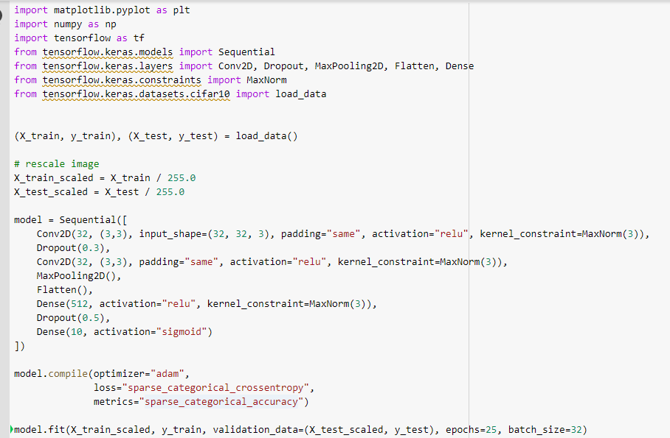
A Sample Network
Given below is a sample code that shows image classification on the CIFAR-10 dataset

Slide 9

A Sample Network
In the previous code, images are of 32x32 pixels in RGB Color and 10 different classes exist with labels from 0-9.
Printing network:
This means that the convolutional layer contains a 3x3 kernal which is applied
on an image of 32x32 pixels and 3 channels. The output will have 32 channels.

